Slide 1

A Socially Relevant Project -I presentation on REAL TIME IMAGE RECOGNITION APPLICATION
Presented by Batch No.: SRP-CSE-19-D-13
N S CHARAN Roll No:20125A0511
JAVALI MONIKA Roll No:20125A0505
VARALA SRI CHAKRI Roll No:19121A05R5
SYED ASLAM Roll No:20125A0522
VAKKALAGADDA SAI KIRAN Roll No:19121A05R2
Computer Science and Engineering
Under the guidance of
J.VENKATRAO
PROFESSOR
Dept. of CSE
HOD:
Dr. B. Narendra Kumar Rao,
Professor & Head,
Dept. of CSE

Slide 2
Contents:
Topic: | Pgno.
PROBLEM STATEMENT | 01
ABSTRACT | 02
OBJECTIVE | 04
INTRODUCTION | 05
SYSTEM REQUIREMENT | 06
SOCIETAL APPLICATIONS | 07
DESIGN | 08
IMPLEMENTATION | 09
REFRENCES | 14

Slide 3

Problem Statement:
Millions of people live in this world with incapacities of understanding the environment due to visual impairment.
In this project, we want to explore the possibility of using the hearing sense to understand visual objects.
The sense of sight and hearing sense share a striking similarity: both visual object and audio sound can be spatially localized.

Slide 4
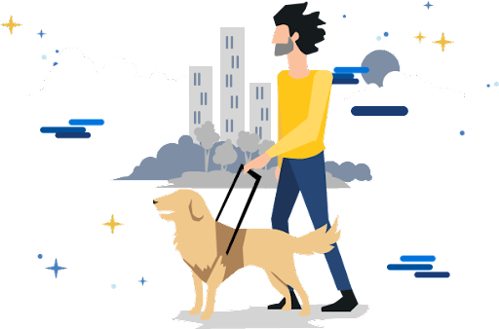
Abstract:
Detecting objects in real-time and converting them into an audio output is a challenging task.
Recent advancement in Computer Vision has allowed the development of various real-time object detection applications.
This project tries to transform the visual world into the audio world with the potential to inform blind people objects as well as their spatial locations. Objects detected from the scene are represented by their names and converted to speech.
This abstract describes a simple android app that will help visually impaired people understanding their surroundings.
The information about the surrounding environment is captured through a phone camera where real-time object recognition is done through API.
The detected objects are then converted into an audio output using Android’s Text to Speech Library.

Slide 5
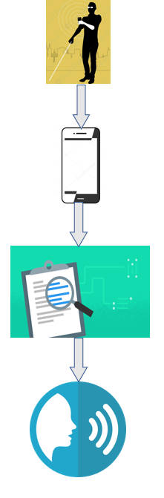
Objective:
The main objective by this project is to create an Android application that converts visual data into speech output.
This is done by using image recognition technology and text-to-speech technology.
Image is taken as an input then text or objects are identified.
The final output is speech of the identified text or object.
Fig: Flow chart of proposed system

Slide 6
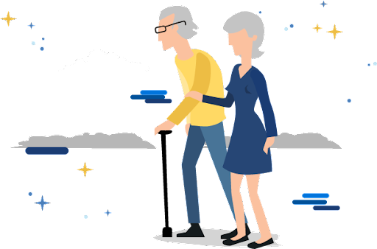
Introduction:
Millions of people live in this world with incapacities of understanding the environment due to visual impairment.
Although they can develop alternative approaches to deal with daily routines, they also suffer from certain navigation difficulties as well as social awkwardness.
For example, it is very difficult for them to find a particular room in an unfamiliar environment. And blind and visually impaired people find it difficult to know whether a person is talking to them or someone else during a conversation.
Computer vision technologies, especially the deep convolutional neural network, have been rapidly developed in recent years.

Slide 7
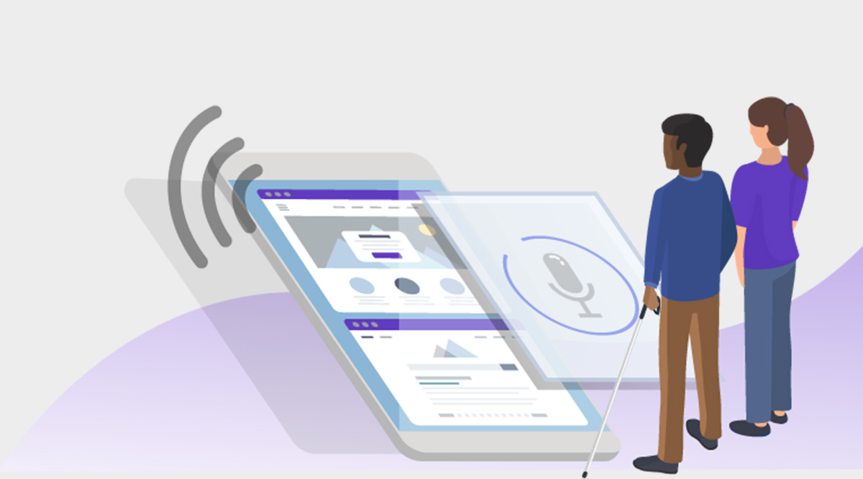
It is promising to use the state-of-art computer vision techniques to help people with vision loss.
It is not often realized by many people that we are capable at identifying the spatial location of a sound source just by hearing it with two ears.

Slide 8
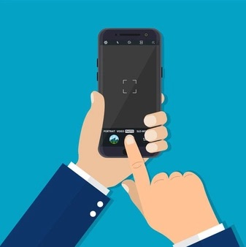
System Requirements:
Android Mobile with Camera : A camera phone is a mobile phone which is able to capture photographs and often record video using one or more built-in digital cameras. It can also send the resulting image wirelessly and conveniently.

Slide 9
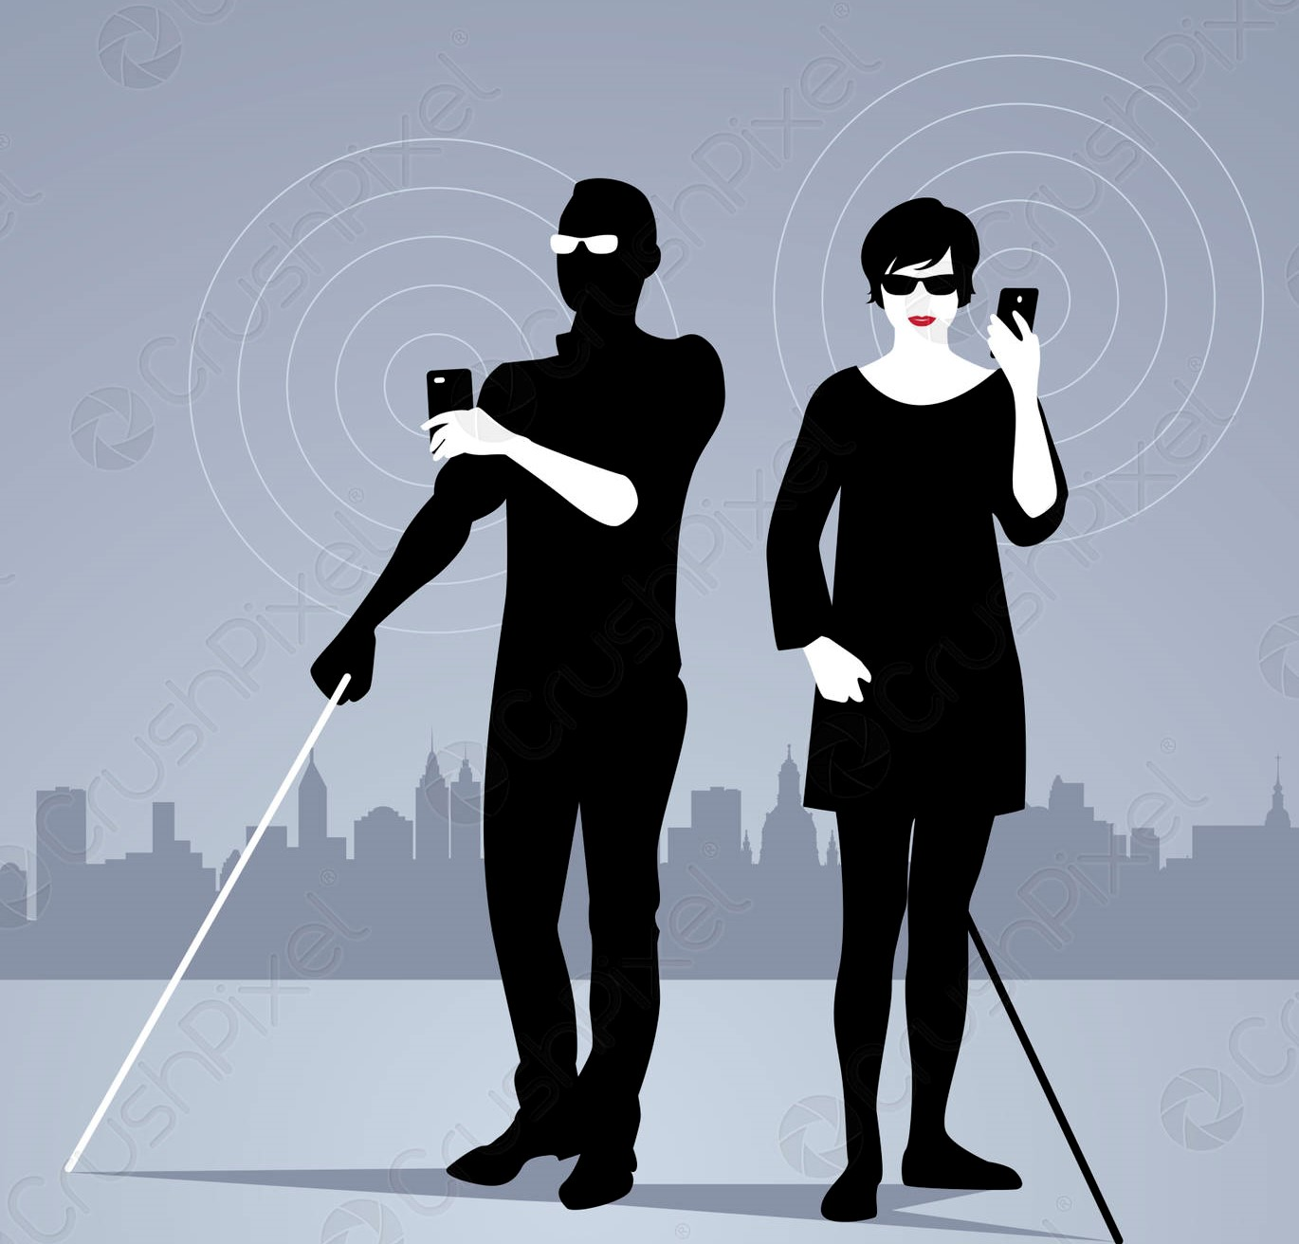
Societal Applications:
This applications is designed to help the visually disabled people.
This application eliminates the difficulty of identifying the objects/text around the person.
This application can also help the elderly to identify text/objects as their vision is low.

Slide 10
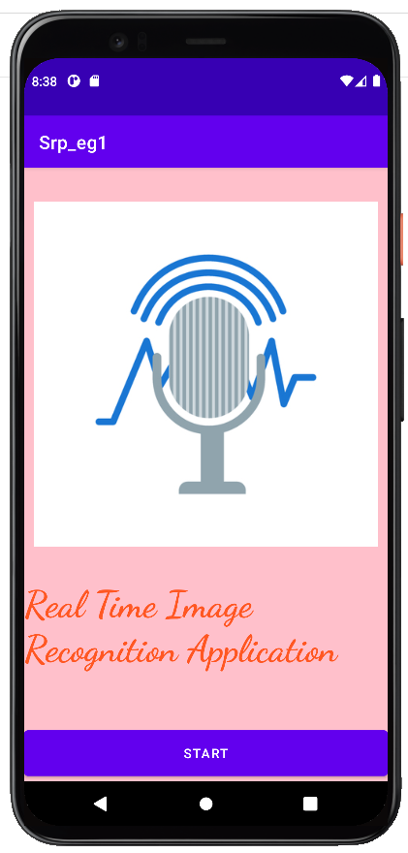
Design Prototype:
Fig: Project Application Start Screen

Slide 11
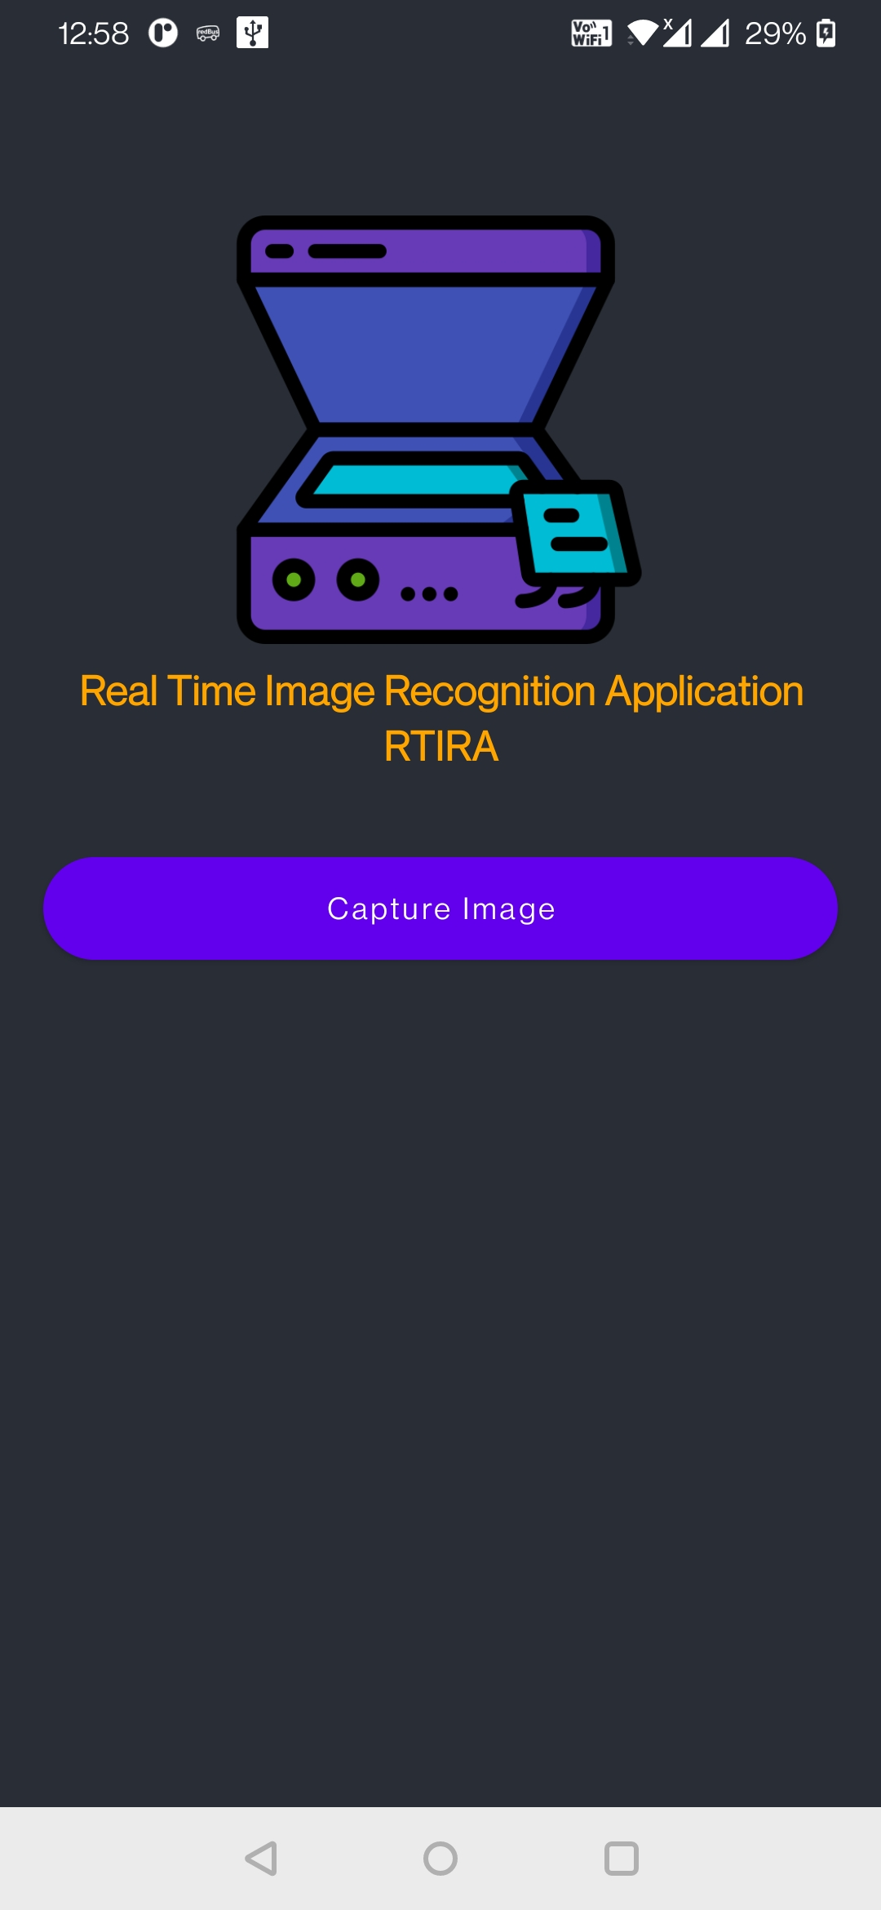
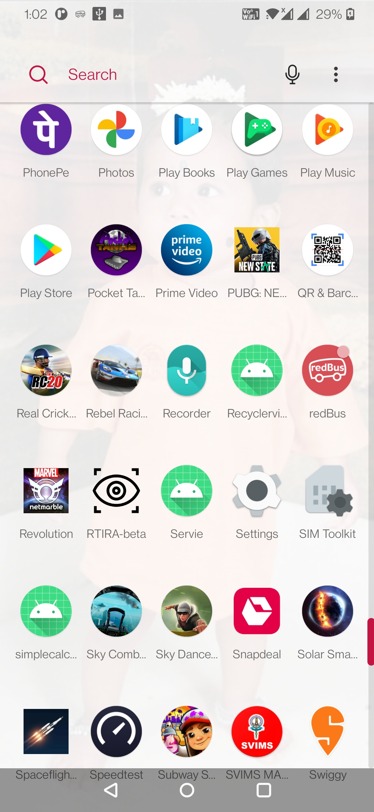
Project Implementation:
Step 1: Open the Application

Slide 12
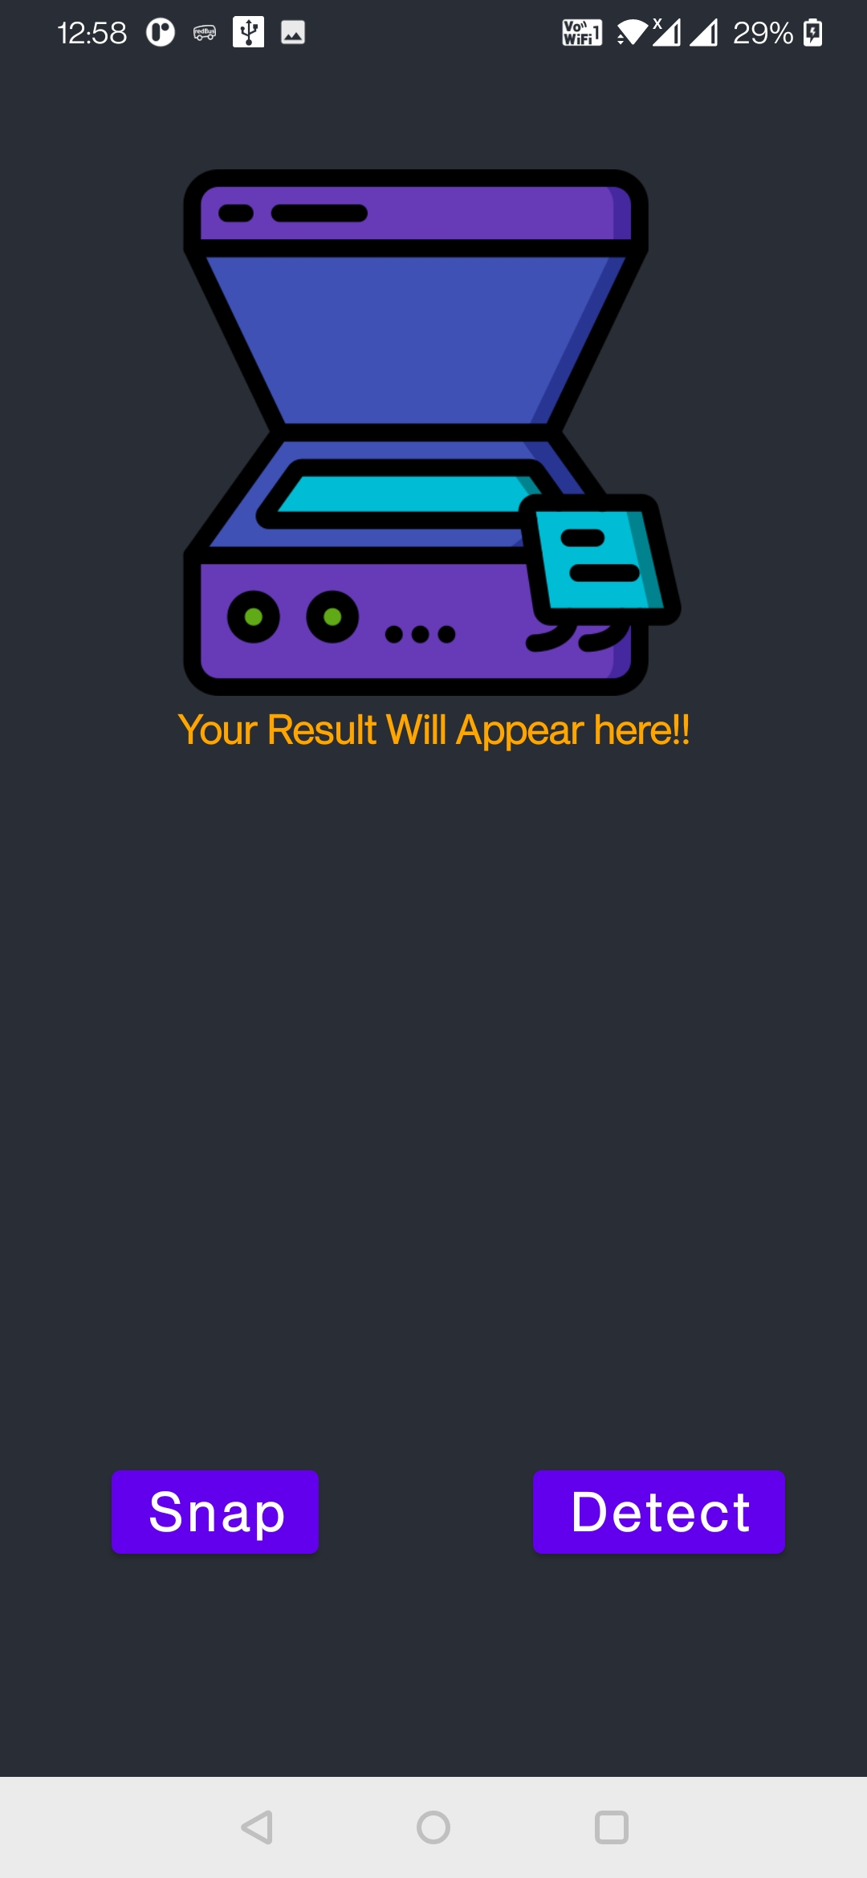
Step 2: Click on Capture Image

Slide 13
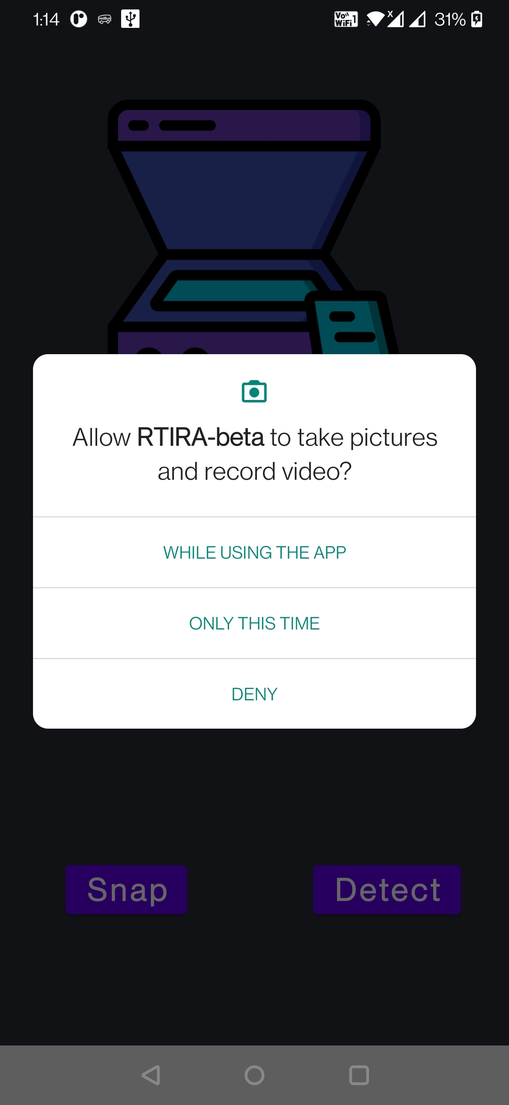
Step3: Give Camera Permissions to Application

Slide 14
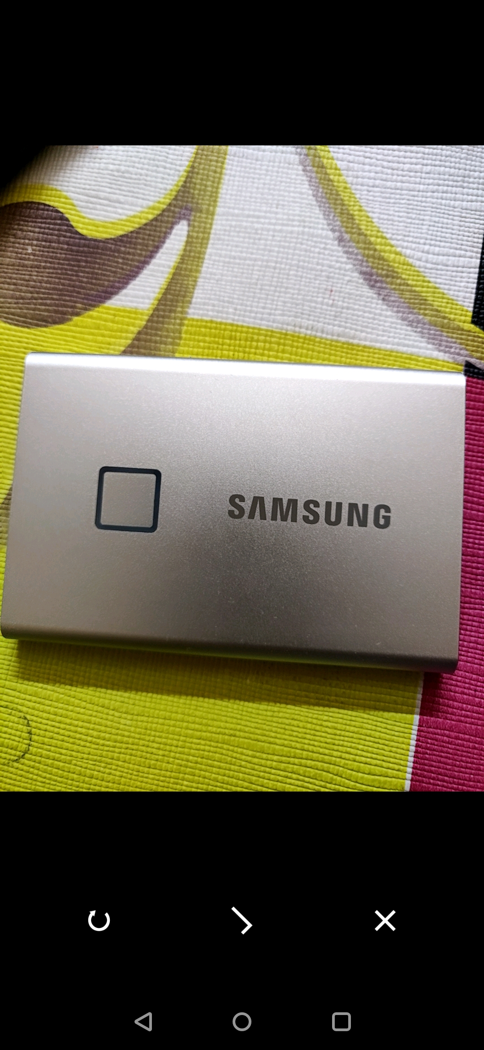
Step 4:Click on Snap to Take an Picture

Slide 15
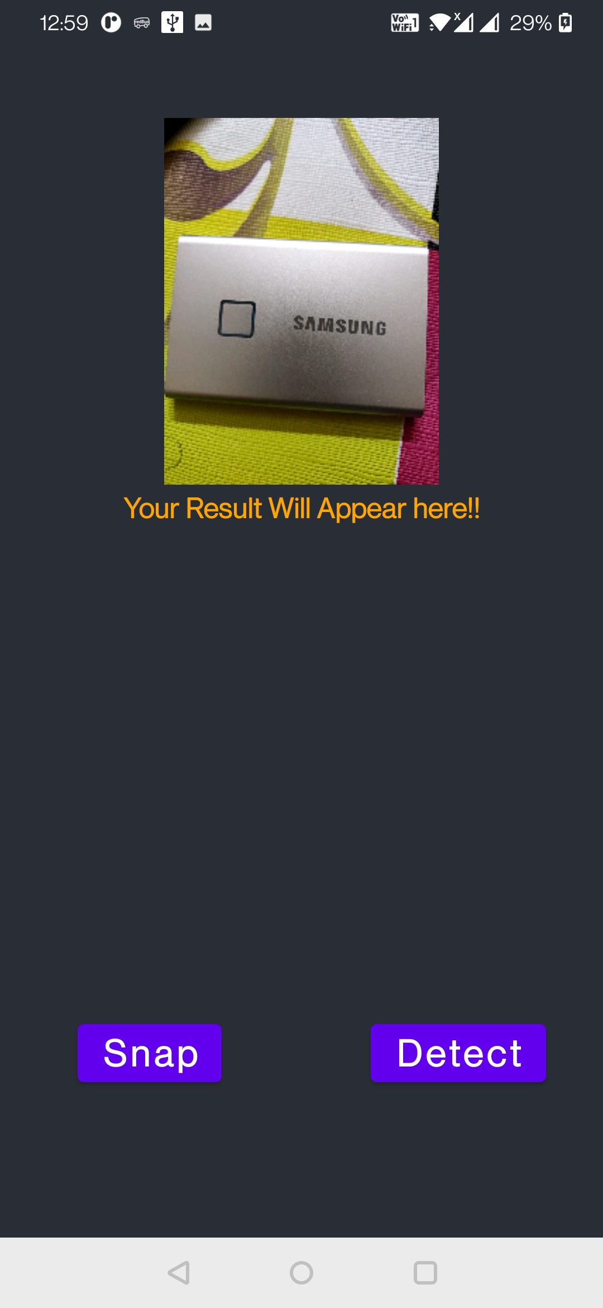

Step 5:Click on Detect to Detect text in Image

Slide 16
References:
Project Files and Code→ Click_here
https://news.microsoft.com/on-the-issues/2019/08/08/smart-tech-blind-low-vision/
https://visua.com/can-visual-ai-help-visually-impaired-people%3F
https://ieeexplore.ieee.org/document/6577195

Slide 17


